Slide 1
Computer Simulation and Modeling
Introduction

Slide 2
Objectives
Transform the physical behavior of a system into a mathematical model that can be transformed into an efficient algorithm for simulation purpose.
Apply the verification and validation techniques to compare the defined model with real system data.
Apply the principles of continuous and discrete-events in system simulation.
Convert abstract model of a system into suitable algorithm that is finally converted into an executable computer program using a suitable programming language.
Apply Artificial Intelligence (A.I.) concepts like Fuzzy Sets and neural networks to model and solve complex systems.

Slide 3
What is Simulation?
Simulation can be defined as a technique for studying real-world dynamic systems by imitating their behavior using a mathematical model of the system implemented on a computer.
The process of interest is usually called a system.
The set of assumptions that we make constitutes the model.
These assumptions take the form of mathematical or logical relationships.
If the relationships are simple, we use analytical solution, otherwise we have to use simulation by numerical methods.

Slide 4
Application Areas of Simulation?
Designing and analyzing manufacturing systems.
Evaluating hardware and software requirements for a computer Systems
Evaluating a new military weapons system or tactic.
Determining ordering policies for an inventory system.
E-business/workflow systems
Analyzing financial or economic systems.
Evaluating designs for service organizations such as hospitals, post offices, or fast -food restaurants.
Designing and operating transportation facilities such as freeways, airports, subways, or ports.
Designing communications systems and message protocols for them.

Slide 5
What is System?
A system is defined to be a collection of entities, e.g., people or machines, that act and interact together to accomplish some tasks.
It depends on the objectives of a particular study.
We categorize systems to be of two types-
Discrete : the state variables change instantaneously at separated points in time
Continuous : the state variables change continuously with respect to time

Slide 6
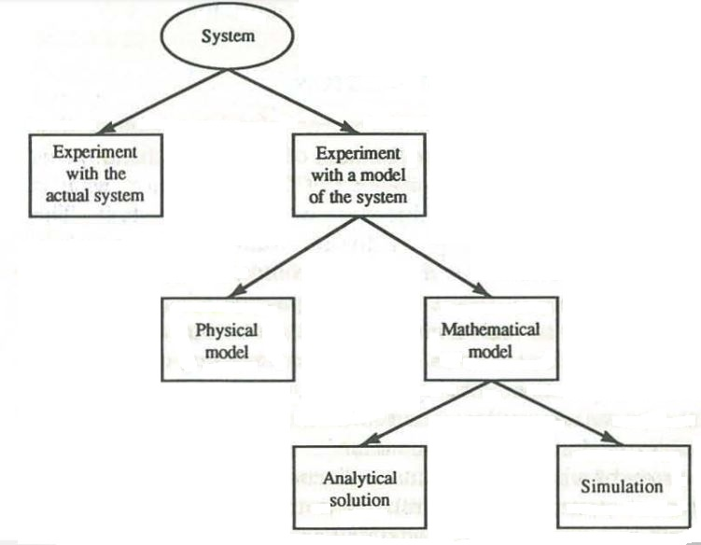
What is System?
Experiment with the Actual System: it is rarely
feasible to do this, because such an experiment would
often be too costly or too disruptive to the system.
Experiment with a Model of the System:
build a model as a representation of the system
and study it as a substitute for the actual system.
Physical Model: also called iconic model. It is thought
to be an image of the actual object.

Slide 7
What is System?
Mathematical Model: representing a system
in terms of logical and quantitative relationships that
are then manipulated and changed to see how
the model reacts.
Analytical Solution: If the model is simple
enough, it may be possible to work with its relationships
and quantities to get an exact, analytical solution.
Simulation: If the model is complex, the model must
be studied by means of simulation, i.e. , numerically
exercising the model .

